Slide 1
Thesis Progress Presentation Direct Integration of Structural Simulation Results into Rigid Body Dynamics
FEA
RBD
Flex
Notes:
Hello everyone , in this presentation I would like to give a status update on my masters thesis on

Slide 2
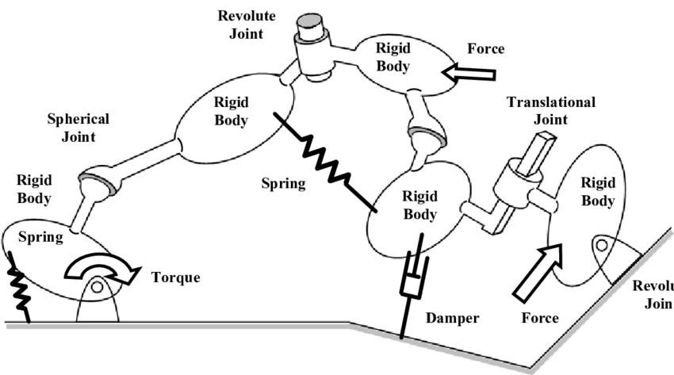
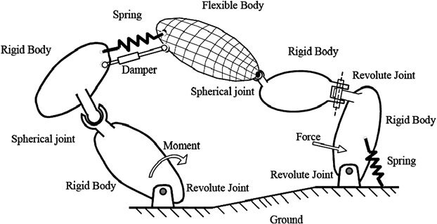
Organizational Info & Thesis Goal
Advisors : Dorit Kaufmann (MMI) , Jan-Lukas Archut (IGMR)
Time duration of the thesis : 22 Weeks
Course : MSc CAME (Faculty 4 Mechanical Engineering)
Goal :
Test a simulation approach that can help in including a flexible body in a RBD simulation.
[3]
[4]
Notes:
My Masters degree comes under faculty 4 and so I can’t officially write a thesis at MMI so it is considered as a external thesis. That’s why I have two advisors one from MMI Miss Dorit and one from IGMR Mr. Jan-Lukas. The duration of my thesis is 22 weeks.
While working with MPCCI during my HIWI job we came across this approach for which there was very little literature and so we decided to test it out in this thesis. This co-simulation approach can help add a flexible / deformable body in a rigid body simulation

Slide 3
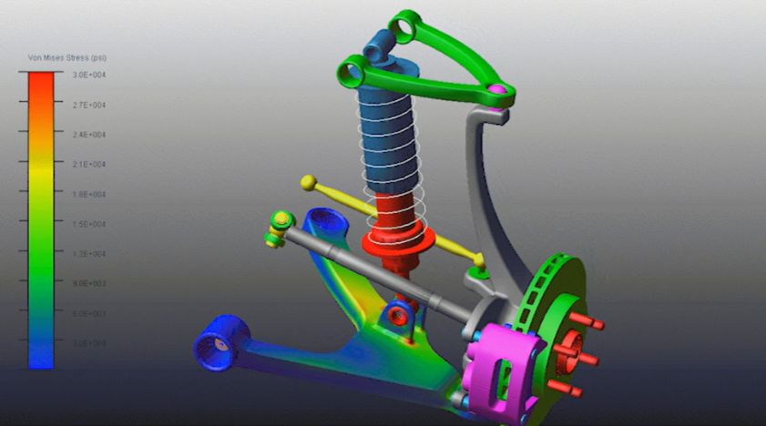
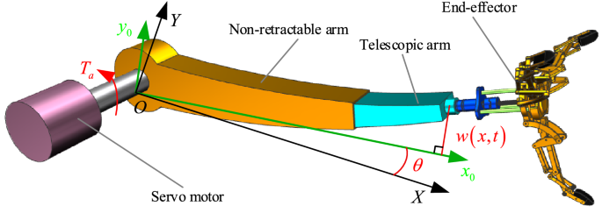
State of the art
Design Optimizations
Flexible RBD
Floating Frame of Reference(FFR)
Absolute Nodal Coordinate Formulation(ANCF)
Nodal FFR
Modal FFR
Co-simulation
[1]
Control of flexible parts
[5]
[2]

Slide 4
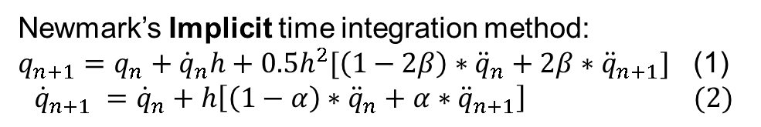
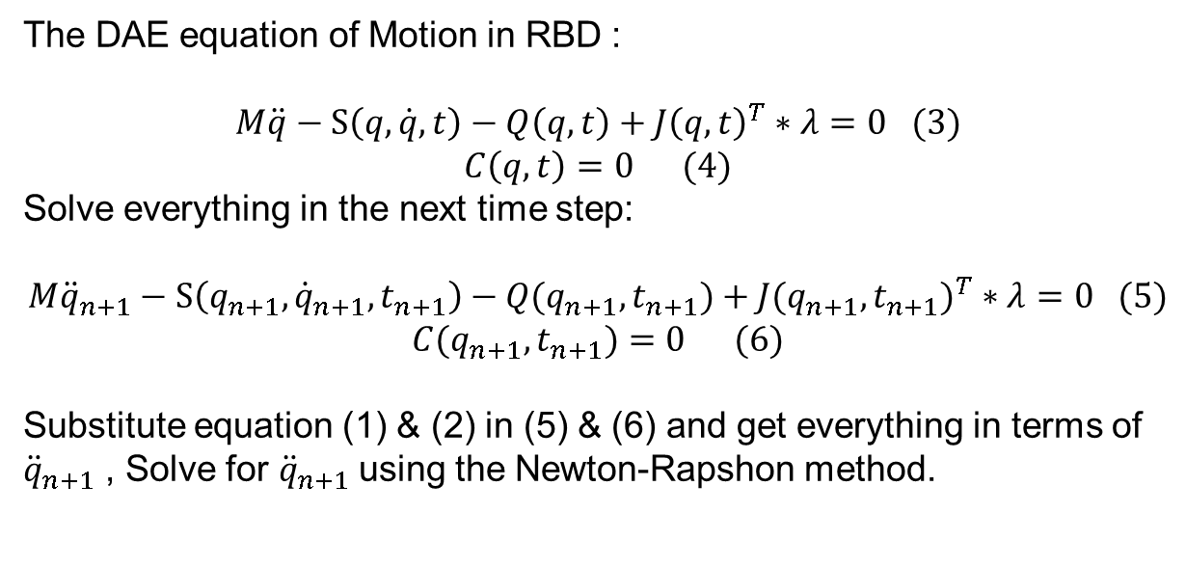
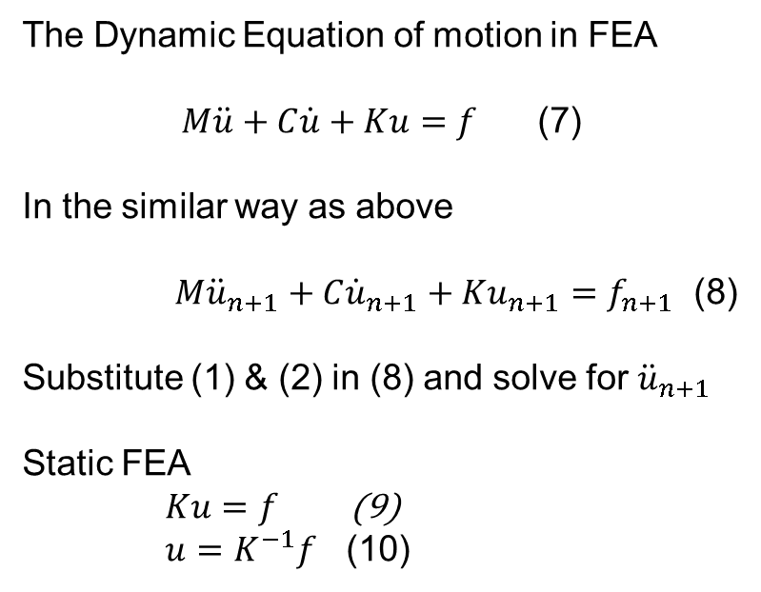
RBD and FEA solution methods
Newmark’s Implicit time integration method:
$q_{n+1}=q_{n}+{\dot{q}}_{n}h+{0.5h}^{2}[\left(1−2β\right)∗{\ddot{q}}_{n}+2β∗{\ddot{q}}_{n+1}]$ (1)
$${\dot{q}}_{n+1} ={\dot{q}}_{n}+h\left[\left(1−α\right)∗{\ddot{q}}_{n}+α∗{\ddot{q}}_{n+1}\right] (2)$$
The DAE equation of Motion in RBD :
$$M\ddot{q}−S\left(q,\dot{q},t\right)−Q\left(q,t\right)+J{\left(q,t\right)}^{T}∗λ=0 (3)$$
$$C\left(q,t\right)=0 (4)$$
Solve everything in the next time step:
$$M{\ddot{q}}_{n+1}−S\left(q_{n+1},{\dot{q}}_{n+1},t_{n+1}\right)−Q(q_{n+1}, t_{n+1})+{J(q_{n+1}, t_{n+1})}^{T}∗λ=0 (5)$$
$$C(q_{n+1}, t_{n+1})=0 (6)$$
Substitute equation (1) & (2) in (5) & (6) and get everything in terms of ${\ddot{q}}_{n+1}$ , Solve for ${\ddot{q}}_{n+1}$using the Newton-Rapshon method.
The Dynamic Equation of motion in FEA
$M\ddot{u}+C\dot{u}+Ku=f$ (7)
In the similar way as above
$M{\ddot{u}}_{n+1}+C{\dot{u}}_{n+1}+Ku_{n+1}=f_{n+1}$ (8)
Substitute (1) & (2) in (8) and solve for ${\ddot{u}}_{n+1}$
Static FEA
$Ku=f$ (9)
$u=K^{−1}f$ (10)

Slide 5
Co-simulation
Traditional way (Elasto-dynamics)[7]
Data Transfer
(One way communication)
Simulation A
(RBD)
Simulation B
(FEA)
Constraint/joint forces
Our approach
Data Transfer
(Two way communication)
Simulation A
(RBD)
Simulation B
(FEA)
Kinematic quantities
Restoring forces
Why Co-simulation :
Pre-existing codes can be utilized avoiding starting from the ground up
A code that transfers data between the two codes needs to be written

Slide 6



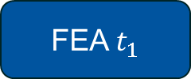


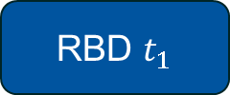
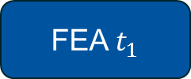

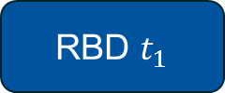


Co-simulation
One way communication [7]
Two way communication
Weak Coupling
Strong Coupling
RBD $t_{0}$
FEA $t_{0}$
Pos, Vel, Acc
Restoring Forces
Constraint Forces
RBD $t_{0}$
FEA $t_{0}$
RBD $t_{0}$
FEA $t_{0}$
RBD $t_{1}$
FEA $t_{1}$
Pos, Vel, Acc
Restoring Forces
Calculate stress
and strain
RBD $t_{1}$
FEA $t_{1}$
RBD $t_{1}$
FEA $t_{1}$
Iterations until equilibrium
is achieved
Why Co-simulation :
Pre-existing codes can be utilized avoiding starting from the ground up
A code that transfers data between the two codes needs to be written

Slide 7
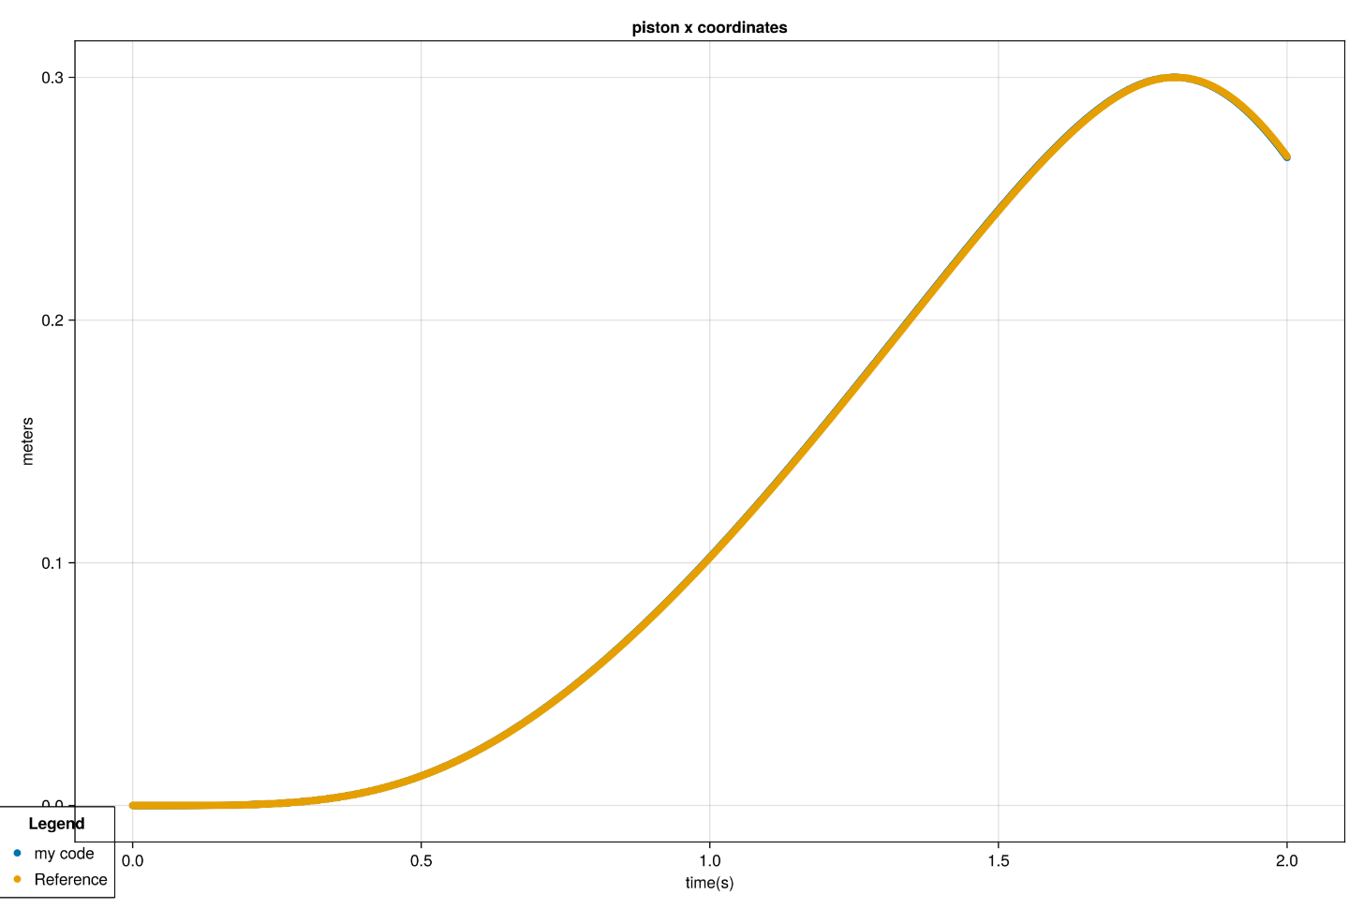


Implementation
The RBD theory explained in the previous slides was implemented in the Julia programming language.
For the FEA part the two matrices namely M (Mass) and K (Stiffness) were imported from ABAQUS and solved in Julia.
The code was validated by comparing the same simulation with MSC Adams

Slide 8
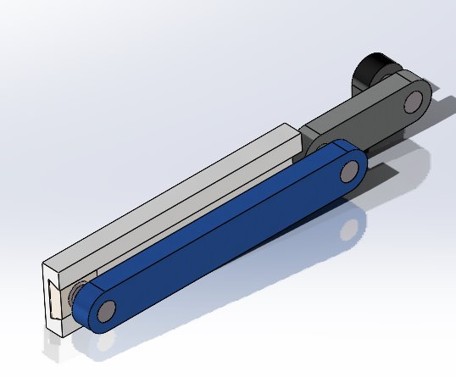
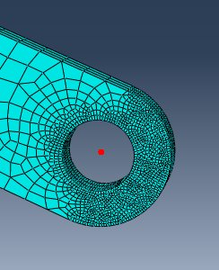
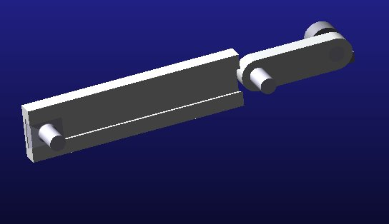
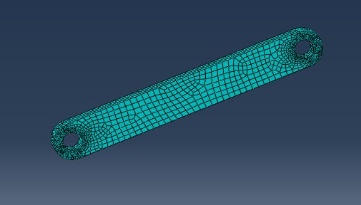
Slider crank CAD
Coupling node that receives
Force from FEA
Separate the flexible and rigid bodies
Coupling node
that receives
Kinematic
quantities from RBD
RBD code
FEA code
Rigid Body is replaced by Forces

Slide 9
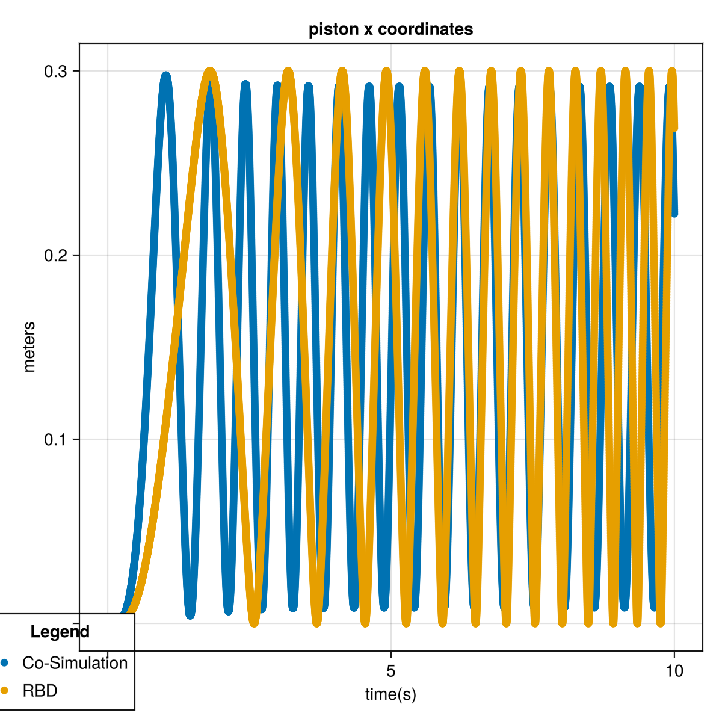
Results (Dynamic RBD - Static FEA Co-simulation)
Weak coupling – Displacement vs time

Slide 10
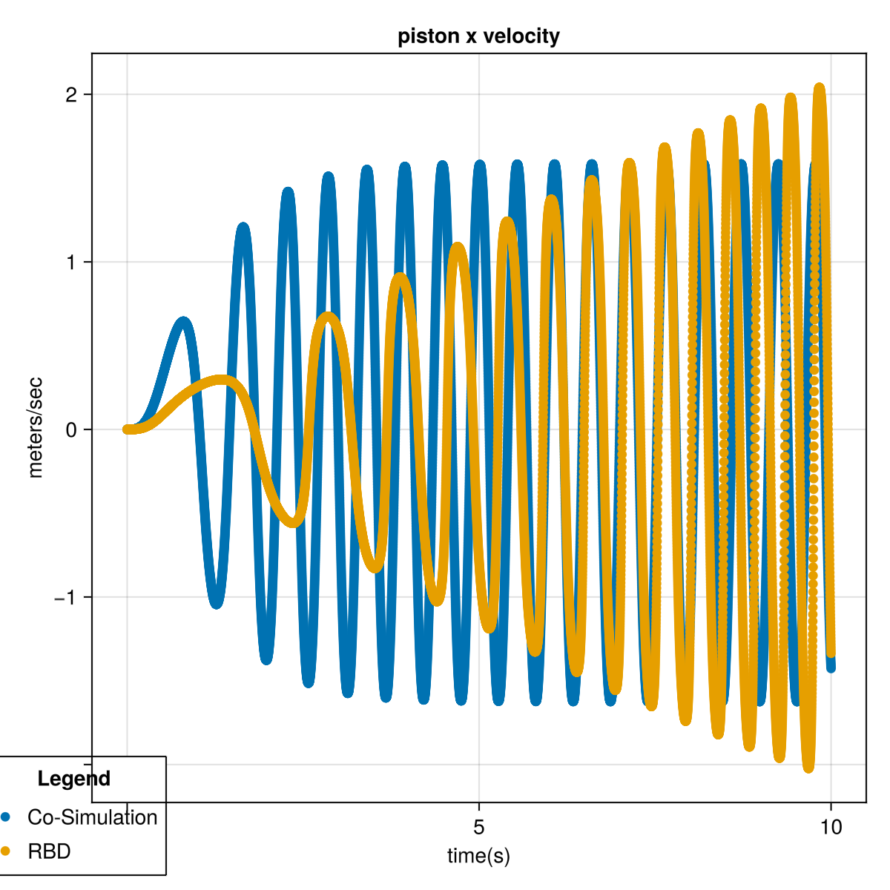
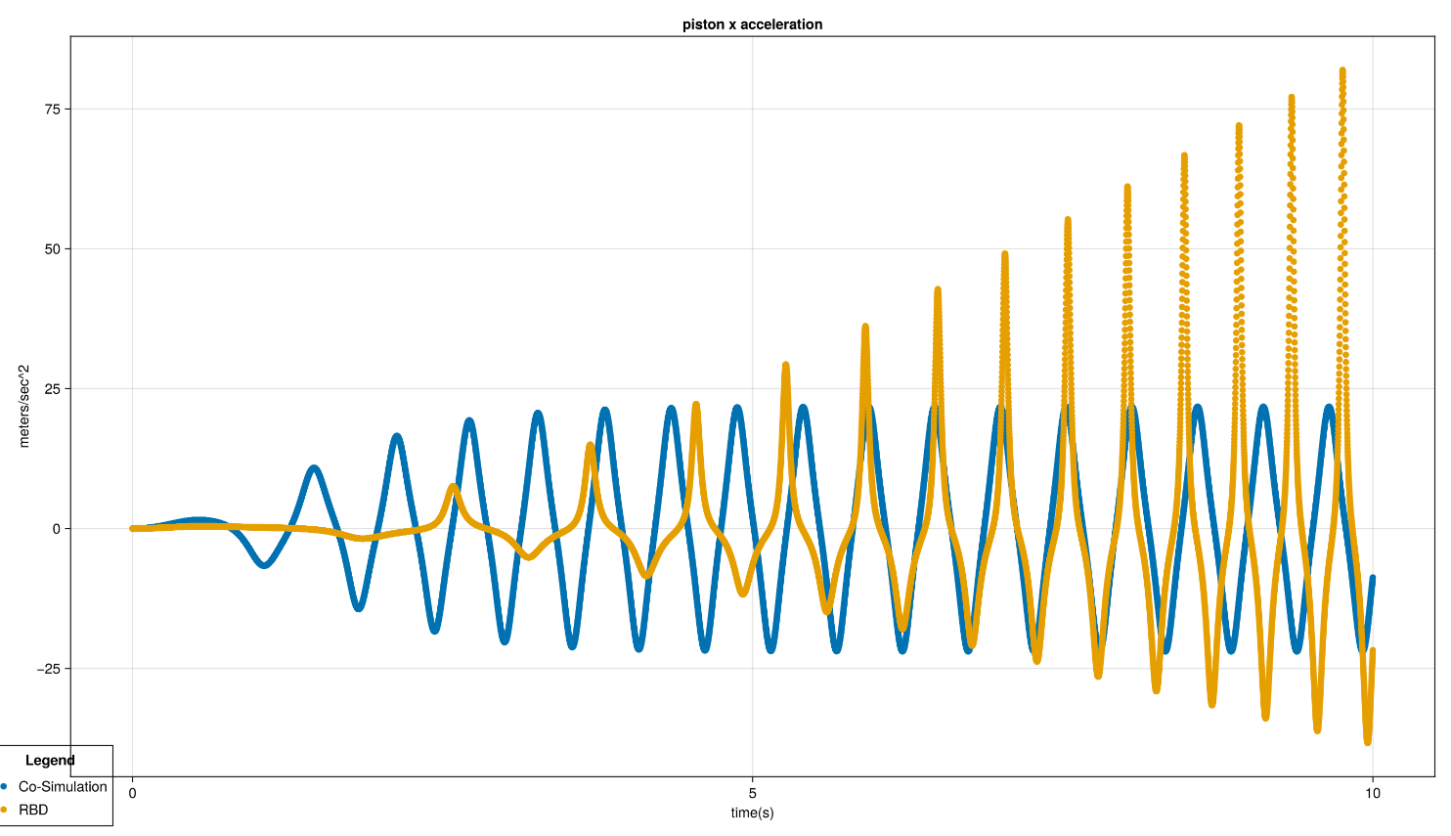
Progress and Findings [Contd..]
Weak coupling – Velocity vs time
Weak coupling – Acceleration vs time

Slide 11
Plan going forward
Coupling | FEA | RBD | status | Plans moving Forward
Weak | Static | Dynamic | Done / results | Documentation
Weak | Dynamic | Dynamic | Done / Failed (Solution diverges in a few steps) | Not worth investigating further. Documentation
Strong | Static | Dynamic | Unfinished | Implement and test
Strong | Dynamic | Dynamic | Unfinished | Implement and test. This could also be unstable.
Strong with springs | Static | Dynamic | Unfinished (backup) | Use springs to control the amount of rigid body motion in FEA

Slide 12
References
[1] https://hexagon.com/it/products/flexible-multibody-systems-adams
[2] Shang, D., Li, X., Yin, M. et al. Rotation Angle Control Strategy for Telescopic Flexible Manipulator Based on a Combination of Fuzzy Adjustment and RBF Neural Network. Chin. J. Mech. Eng. 35, 53 (2022). https://doi.org/10.1186/s10033-022-00723-2
[3] Portal, R.J.F., Dias, J.M.P. (2006). Multibody Models for Vehicle Accident Reconstruction. In: Motasoares, C.A., et al. III European Conference on Computational Mechanics. Springer, Dordrecht. https://doi.org/10.1007/1-4020-5370-3_775
[4] Rong, B., Rui, X., Wang, G. et al. New efficient method for dynamic modeling and simulation of flexible multibody systems moving in plane. Multibody Syst Dyn 24, 181–200 (2010). https://doi.org/10.1007/s11044-010-9196-9
[5] Gufler, V., Wehrle, E. & Zwölfer, A. A review of flexible multibody dynamics for gradient-based design optimization. Multibody Syst Dyn 53, 379–409 (2021). https://doi.org/10.1007/s11044-021-09802-z
[6] https://grabcad.com/library/slider-crank-mechanism-102
[7] Shabana, A.A. Flexible Multibody Dynamics: Review of Past and Recent Developments. Multibody System Dynamics 1, 189–222 (1997). https://doi.org/10.1023/A:1009773505418
[8] http://www.benchtophybrid.com/AE_Parts_Power.html
[9] https://makeagif.com/gif/slider-crank-mechanism-NSoRC8

Slide 13
Utkarsh Kulkarni
Institut für Mensch-Maschine-Interaktion
RWTH Aachen
www.mmi.rwth-aachen.de
www.youtube.com/VEROSIMSimulation

